Slide 1


Tobacco Use and Mortality
Pathan AyanKhan

Slide 2


Objectives
Data Cleaning
Statistics
Analysis
Standarizing the Features
Applying K-means Clustering
Modeling

Slide 3
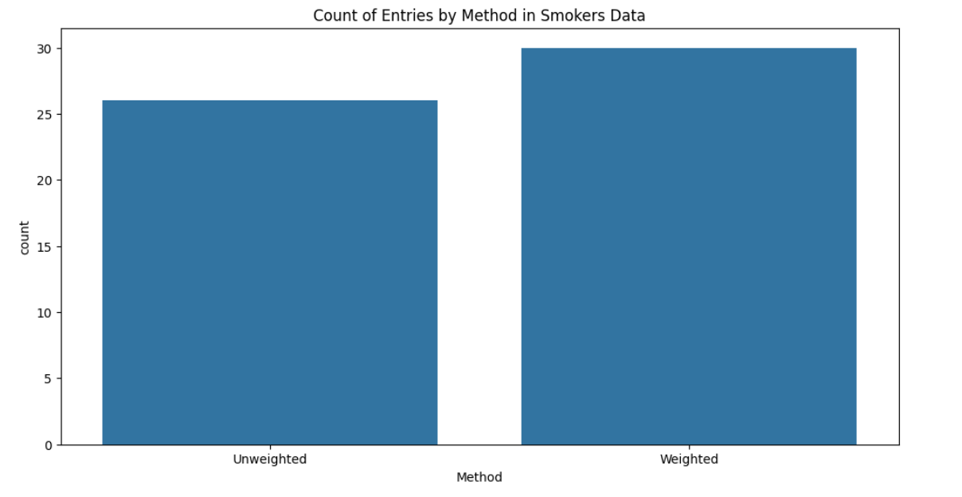
Analysis

Slide 4
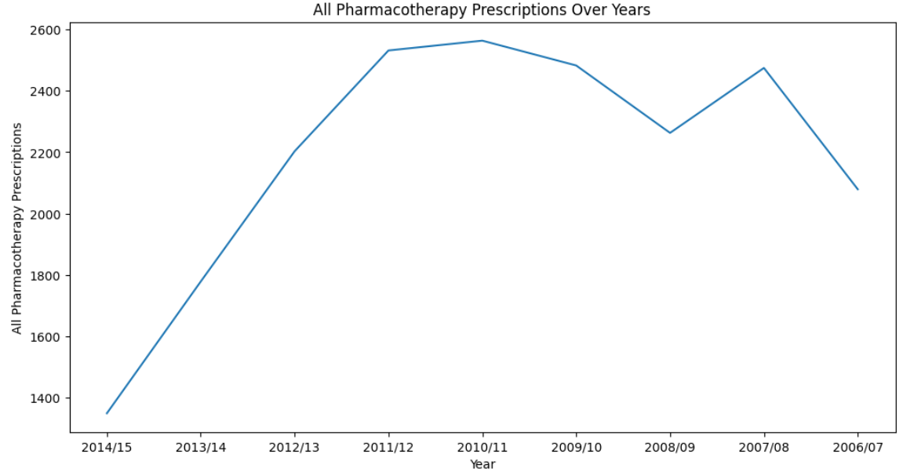
Analysis

Slide 5
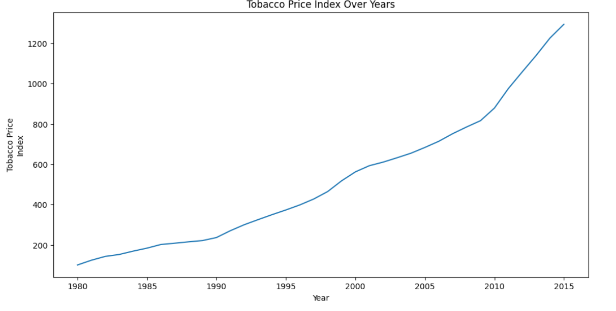
Analysis

Slide 6
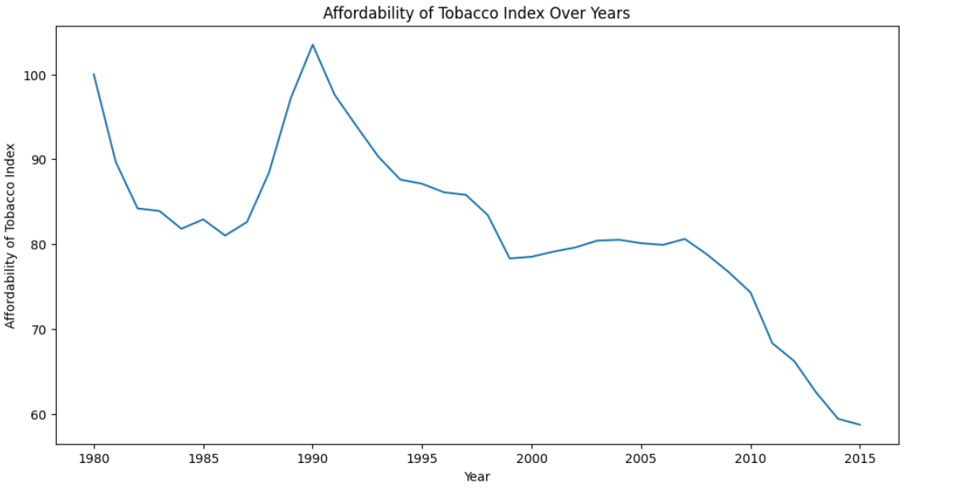
Analysis

Slide 7
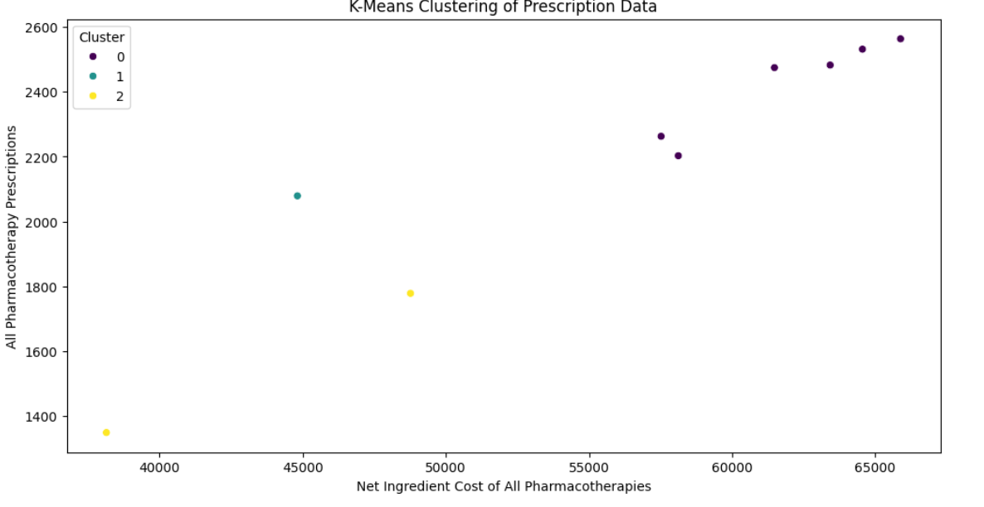
Clustering

Slide 8
Thank You…

